Slide 1
DSP Lab – Audio and Speech Part
Week 1: Python tutorial &
Energy-based Voice Activity Detection (VAD)
劉奕汶、李祈均 老師
助教: 周惶振、陳永慶、楊皓鈞、黃志翔

Slide 2
Outline
Goal
Preparation
Python Introduction(Review) & installation
Code Example
Tips
VAD using power(energy)
Demo Requirements
Report Requirements

Slide 3


Slide 4
Goal
Week1: Python Tutorial & Energy-based Voice Activity Detection (VAD)
Week2: Mel-Frequency Cepstral Coefficients (MFCC) Introduction & Extraction
Week3: Cross-validation & Support Vector Machine (SVM) Classifier
Week4: Laughter And Speech Detection

Slide 5
Preparation
Pip
Python 3.0 up
Python library:
matplotlib.pyplot
scipy.io.wavfile
Numpy
Math
Microphone (optional)

Slide 6
Packages Installation
Python (Suggestion: Anaconda Spyder)
Pip (if you do not use Anaconda Spyder, you maybe need to install pip.)
Download get-pip.py via https://bootstrap.pypa.io/get-pip.py to a directory on your computer.
Run: python get-pip.py

Slide 7
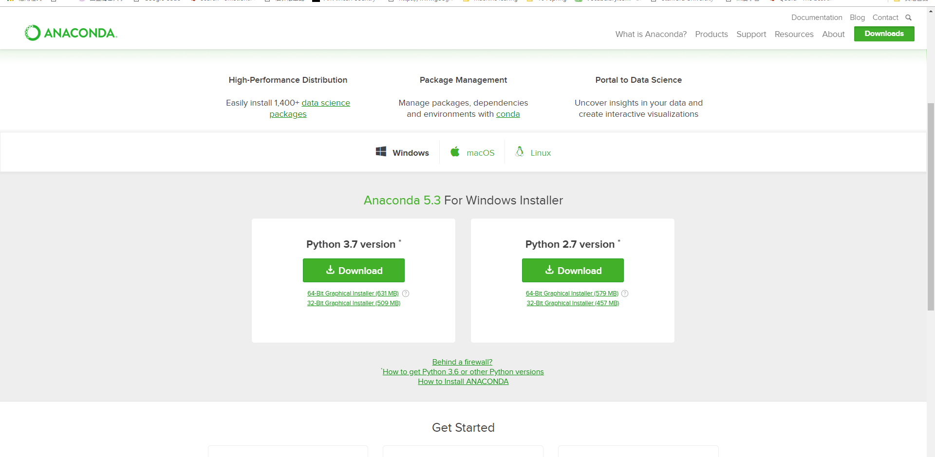
Notes:
https://www.anaconda.com/download/

Slide 8
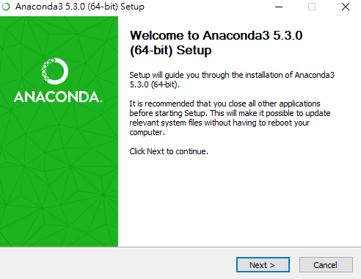

Slide 9
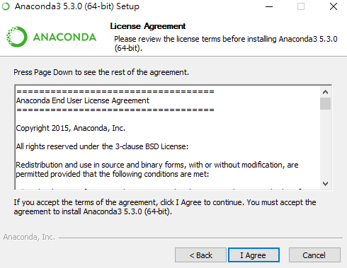

Slide 10
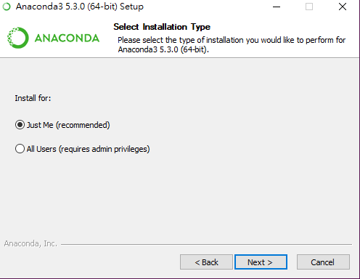

Slide 11
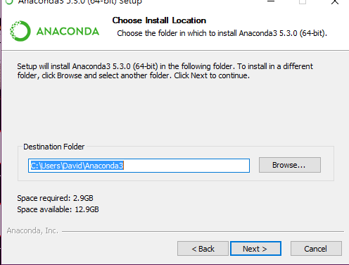

Slide 12
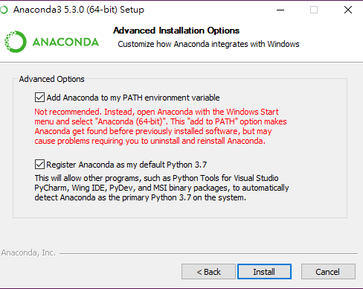

Slide 13
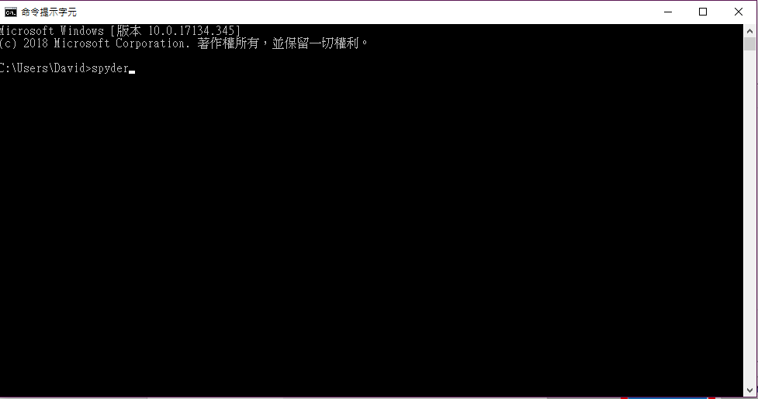

Slide 14
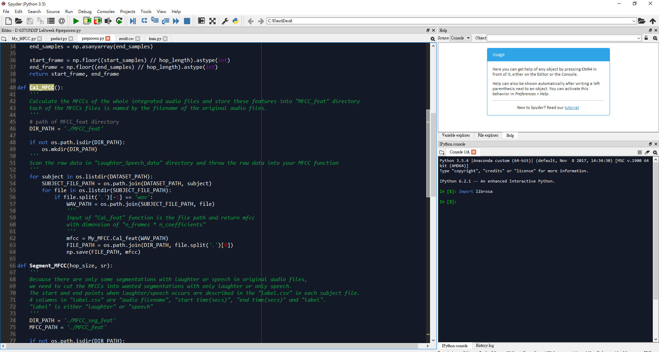

Slide 15
Why Python

Slide 16
Python Characteristic
Object-oriented programming language
Using whitespace indentation rather than curly braces to delimit blocks (In spyder, you can use “tab” hotkey.)
Automatically detect the variable type

Slide 17
First step
How to print
Python 3.0 up : print(‘hello world!’)
Python 3.0 down: print ‘hello world’
“XXX” = ‘XXX’
Wrong : ‘XXX”

Slide 18
Some Tips(in spyder)
Comment : alt+1(un/comment)
Show the last run code : alt+p
Do not use ; to end the every line code
If you want to change line you should add parentheses
Ex : if(z==3.45 and
y==1)
In array always begin with 0 not 1

Slide 19
Basic operations
Change type
int(variable)、float(variable)、str(variable)
Condition
if-else
if-elif-else
Function
def function name(argument):
function code

Slide 20
String
A=“hello”
A[0] = “h”
A[1:4] = “ell” (not include 4)
A[:3]=“hel”(from 0 to 2)
A[2:]=“llo”(from 2 to final)
A[:-1]=“hell”(from 0 to 3)
print (A*2) = “hellohello”
print (A+”t”) = “hellot”

Slide 21
Loop
for-in
ex:
a=0 w=[1,2,3]
for i in w:
a=a+i
print(a)
for-in range
ex:
for t in range(3):
print(t)
for t in range(1,9,2):
print(t)

Slide 22
Loop
while
ex:
sum=0 i=1
while i<=10:
sum+=I
i+=1
print(sum)

Slide 23
How to use numpy
import numpy as np
np.array, np.arange, np.zeros, np.sin, etc.
http://myshare.dscloud.me/scipydoc/numpy_intro.html

Slide 24
Example Code

Slide 25
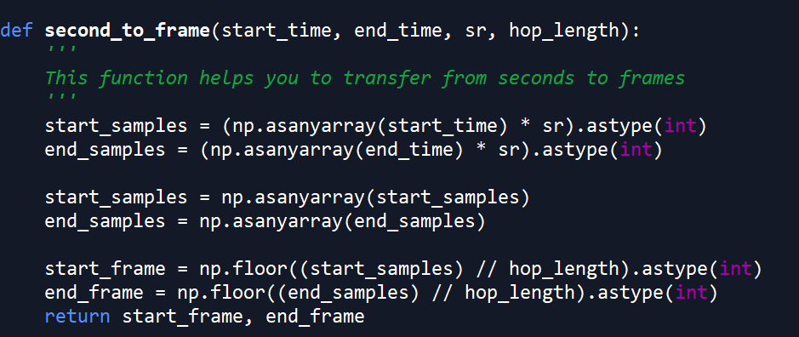
Create Function

Slide 26
Plot Wave
import matplotlib.pyplot as plt
plt.subplot
plt.title
plt.plot
plt.axvline(x=X_value,c='r’) (Vertical line)
Please reference https://matplotlib.org/api/pyplot_api.html
import matplotlib.pyplot as plt
plt.subplot
plt.title
plt.plot
plt.axvline(x=X_value,c='r’) (Vertical line)
Please reference https://matplotlib.org/api/pyplot_api.html

Slide 27
Read csv
import csv
Read_path = 'D:/10710/DSP Lab/week 4/result.csv’
with open(Read_path, newline='') as csvfile:
spamreader = csv.reader(csvfile, delimiter=' ', quotechar='|’)
for row in spamreader:
print(row)

Slide 28
Week1: Python Tutorial & Energy-based Voice Activity Detection (VAD)

Slide 29
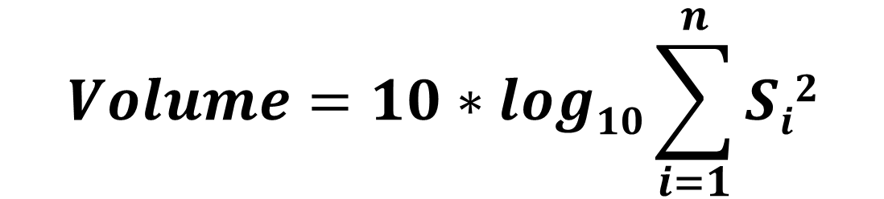
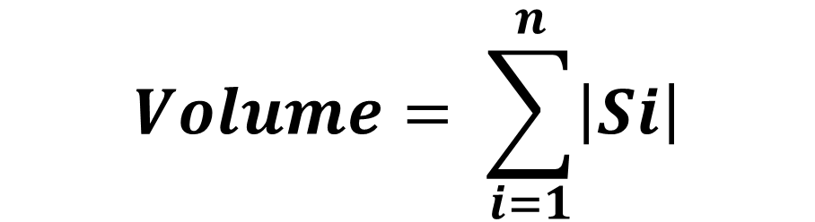
Energy-based VAD
Calculate Volume
$$Volume= \sum_{i=1}^{n}{\left|Si\right|}$$
or
$$Volume=10∗log10\sum_{i=1}^{n}{Si2}$$

Slide 30
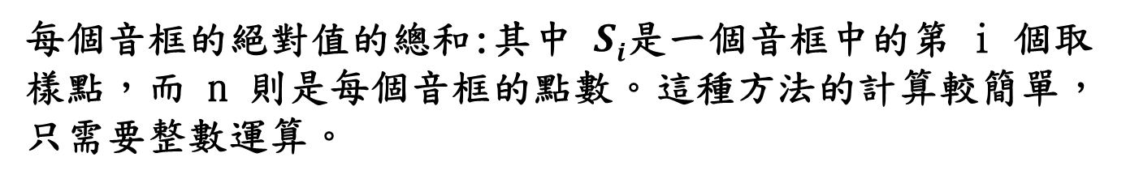
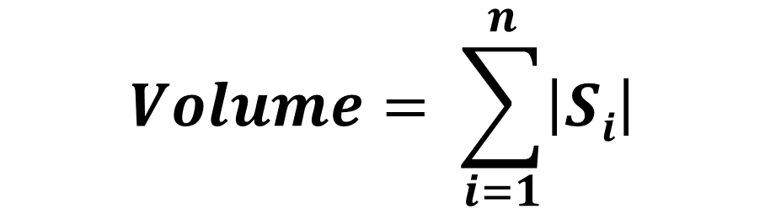
Energy-based VAD
Calculate Volume
$$Volume= \sum_{i=1}^{n}{\left|Si\right|}$$
$\text{每個音框的絕對值的總和}$:其中 $Si$是一個音框中的第 i 個取樣點，而 n 則是每個音框的點數。這種方法的計算較簡單，只需要整數運算。

Slide 31
Tips
Calculate Energy (use window including frame size, overlap size and step size)
Set Threshold: e.g., max(), min(), or (max()*weight + min()*weight)…
Find > threshold index frame
Concatenate the frames which > threshold
Plot Wave Time domain figure (amplitude & energy version)

Slide 32
Demo Requirements

Slide 33
Demo in Lab
Do Energy-based VAD method on laughter & digits audio)
Plot start-end lines in Time Domain
Plot threshold lines in Energy Domain. (You can set different types of thresholds)
Write laughter segments stream into audio file (File format: .wav)

Slide 34
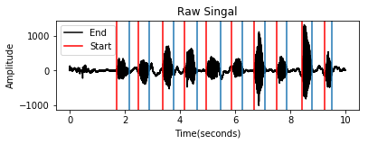
Plot Start-End line

Slide 35
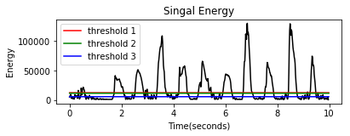
Plot threshold lines example

Slide 36
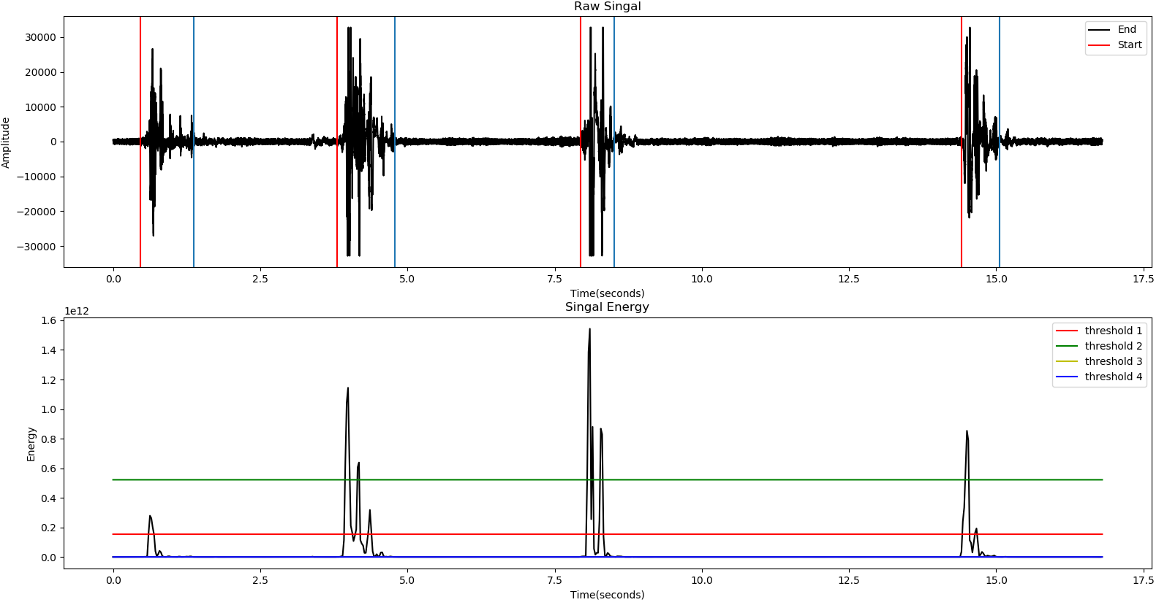
Demo

Slide 37
Report Content Requirement
Abstract/Introduction
Goals of this lab
Method
Pseudo code
Flow chart
Results
References (if you have)

Slide 38

Thank You

